Slide 1
IMPACT OF CLIMATE CHANGE ON WATER CYCLE
AQUA EXPLORERS

Slide 2
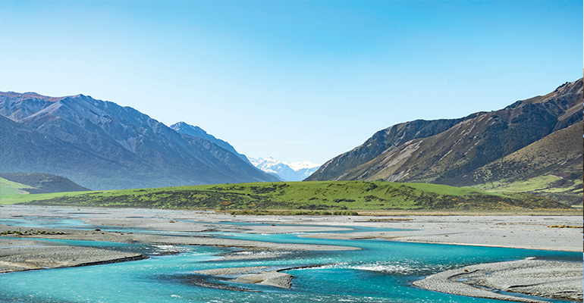
OVERVIEW
WATER CYCLE
The water cycle shows the continuous movement of water within the Earth and atmosphere.
CLIMATE
The weather conditions prevailing in an area in general or over a long period.

Slide 3
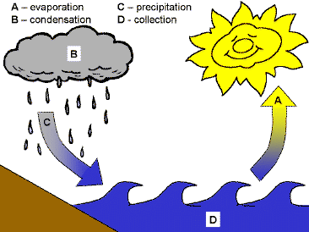
BASIC WATER CYCLE COMPONENTS
EVAPORATION
PRECIPITATION
CONDENSATION

Slide 4

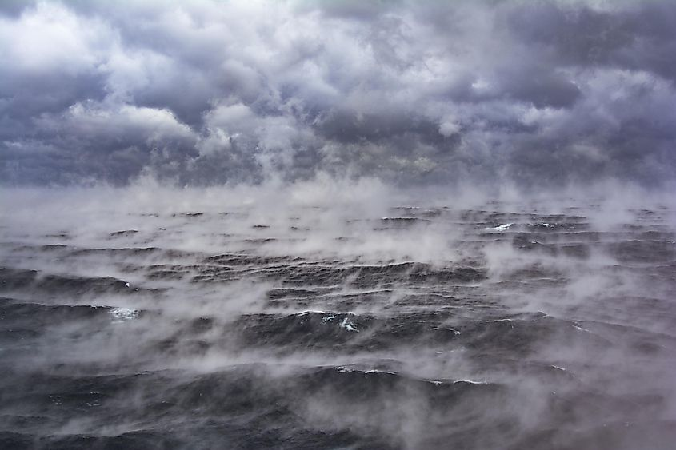
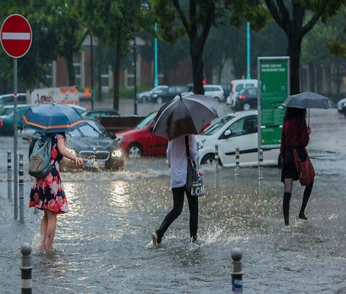
IMPACT OF CLIMATE ON WATER CYCLE
1.Increase In Evaporation
this lead to great water lost from lakes, rivers etc
2.Altered precipitation
climate change can lead to shifts in precipitation pattern causing more intense rainfall in some areas and prolonged droughts in others.
3.Impact on Ecosystem
change the water cycle can harm aquatic ecosystems by altering water temperature, reducing habitant availability and affecting the distribution of species.

Slide 5


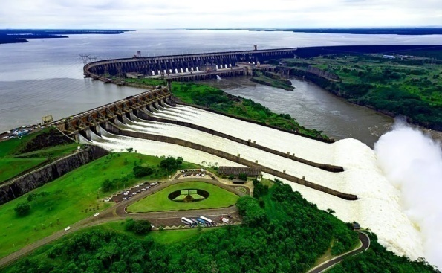
WHAT CAN WE DO?
Incorporate climate-smart farming methods. Farmers can use climate forecasting tools, plant cover crops, to help manage climate-related production threats.
Treat Ecosystem responsibly Practice management techniques that improve ecosystems’ health and help them be more resilient to a changing climate. For example, plant native vegetation and conserve water. In arid places planting native or drought resistant species conserves water.
Build sustainable water infrastructure Communities can maintain and renew aging water systems with planning tools, financing help, best practices, and new technologies.

Slide 6

DID YOU KNOW?
Venus, rain is made of sulfuric acid, rather than water. However, the planet is so hot that this rain evaporates before it reaches the surface.
Raindrops fall at an average speed of 14mph.
The water cycle began about 3.8 billion years ago, when the oceans formed as a result of rain falling on a cooling earth.
Only 0.35% of the world’s water is water vapour in the atmosphere.
VISIT OUR WEBSITE FOR MORE EXPLANATION:
https://muntakasarkimuhamm.wixsite.com/everythingstartswith

Slide 7
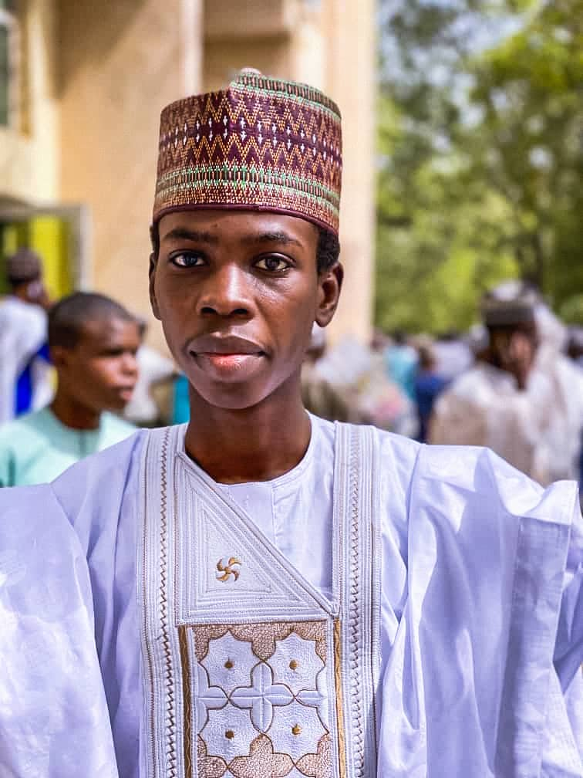
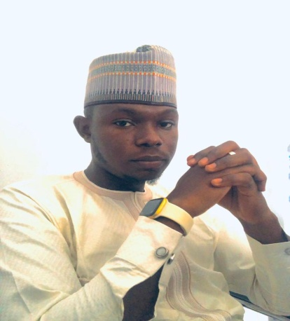
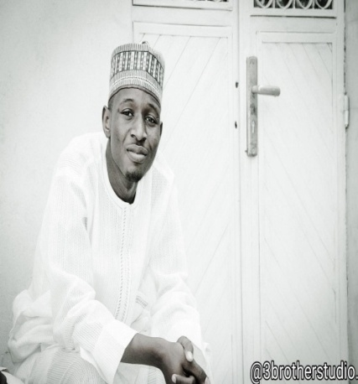
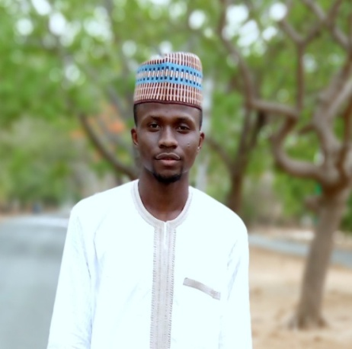
TEAM MEMBERS
SHAMSUDEEN MUHAMMAD MUSA
MEDICAL LAB SCIENTIST
MUHAMMAD MUNTAKA SARKI
DATA ANALYST
ABDULLAHI SUNUSI BELLO
CIVIL ENGINEER
ABUBAKAR ABUBAKAR SADIQ
CHEMIST

